Slide 1

CAPSTONE PROJECT REVIEW I Customer Churn Prediction using ANN
Name : Tushar Maurya
Register No:19BCE1856
Programme & Specialization : B.Tech CSE
Guide Name:
Dr. K. Sathyarajasekaran

Slide 2
Outline
Introduction
Literature Review (15 Latest Papers – Minimum - from Reputed Journals/Conferences)
Research Gap
Problem Statement
Research Motivation
Research Challenges
Research Objective
What is to be done next (1 Slide)
Research Paper Status
Guide Approval mail snapshot
References

Slide 3
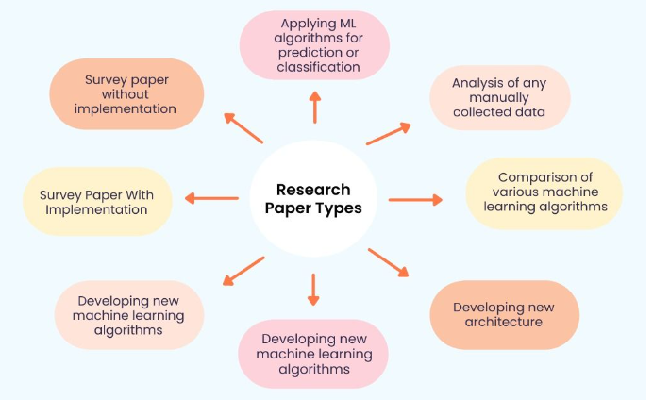

Slide 4
Introduction
Businesses around the world are evolving every day which has drastically led to the growth of two major fields Artificial intelligence and Machine Learning.
Technology based on AI and ML has recently developed to such an extent that it has become an essential element of the largest online stores on the web.
Most of the work in the online store is automized.

Slide 5
Other fields where ML and AI have achieved excellence:-
Speech recognition(Voice search, appliance control, Alexa Home, Google Home)
Virtual Assistant(Alexa, Siri)
Image recognition(facial, non-living things)
Google Translation(Language translation)
Traffic Alerts in Google Maps
Self-driving cars(Waymo)
Medical diagnosis
Predictive analytics(Loan prediction, SIP amount prediction)
Recommender System(Music and movie Recommendations)

Slide 6
Background Work, Challenges
The main work behind the scene is the phase of learning because it’s true that AI and ML are very vast topics.
So every day, I am learning new algorithms and focusing on building better practical models, and learning how to optimize the model in a better way because I felt in most cases the model is already prepared its about the space that is so large or the accuracy that is so bad.
I also faced issues while studying and selecting the correct material for different topics as most of the courses were either highly paid or the courses on youtube aren’t reliable.

Slide 7
The main challenge was selecting the final idea as the field is evolving at its peak because of the tech giants like Amazon, Alibaba, Flipkart, and Walmart.
Every day I read one article in the morning since I enrolled in the capstone project as working on this idea as my final project was one of my dreams when I joined the college due to the placements I was not very regular but still I was able to make ends meet.
The Research paper was not a difficult part as I was getting the idea of how to implement it by reading so much in the right direction.

Slide 8
Literature Review/Survey
S.No | Paper Title (APA Format) | Summary | Algorithms Used | Pros / Cons
[1] | The Impact of Customer Satisfaction and Relationship Quality on Customer Retention: A Critical Reassessment and Model Development [1997] Author :Thorsten Hennig-Thurau and Alexander Klee (University of Hanover) | Develop a conceptual foundation for investigating the customer retention process, with the use of the concepts of customer satisfaction and relationship quality. | Decision Tree | Pros: Better understanding of customer
[2] | Churn Prediction: Does Technology Matter? [2006] Author: John Hadden, Ashutosh Tiwari, Rajkumar Roy, and Dymitr Ruta | Comparison of various algorithm | Decision Tree, Regression | Regression had higher accuracy.

Slide 9
S.No | Paper Title (APA Format) | Summary | Algorithms Used | Pros / Cons
[3] | Scikit-learn: Machine Learning in Python [2012] Author: Fabian Pedregosa, Gaël Varoquaux, Alexandre Gramfort, Vincent Michel, Bertrand Thirion, Olivier Grisel, Mathieu Blondel, Peter Prettenhofer, Ron Weiss, Vincent Dubourg, et al | Scikit-learn exposes a wide variety of machine learning algorithms, both supervised and unsupervised, using a consistent, task-oriented interface, thus enabling easy comparison of methods for a given application. | Technologies used: Numpy, Cython, Scipy | Pros: Further algorithm can be used designed using this
[4] | Customer Churn Prediction in Telecommunication A Decade Review and Classification [2013] Author: Nabgha Hashmi ,Naveed Anwer Butt and Dr.Muddesar Iqbal | Data mining techniques help telecom industry in this perception by providing techniques to identify such customers so that retention actions could be targeted upon them. | Decision Trees Regression Cluster Analysis | Pros: contribution in the field of customer churn predictive modeling in telecommunication

Slide 10
S.No | Paper Title (APA Format) | Summary | Algorithms Used | Pros / Cons
[5] | An Integrated Framework to Recommend Personalized Retention Actions to Control B2C E-Commerce Customer Churn [2015] Author: Shini Renjith | Find the customer who left Find churners Extract loyal customers | logistic regression k-means clustering collaborative filtering mechanism | Cons: Separate algorithm for separate work.
[6] | Predicting Shipping Time with Machine Learning. [2015] Author: Antoine Jonquais, Florian Krempl Advisor, Dr. Roar Adland, Dr. Haiying Jia | Make predictions regarding shipping times between South East Asia and North America, from factory to port of destination. | Random Forest Neural Network Linear Regression

Slide 11
S.No | Paper Title (APA Format) | Summary | Algorithms Used | Pros / Cons
[7] | LightGBM: A Highly Efficient Gradient Boosting Decision Tree [2017] Author: Guolin Ke , Qi Meng , Thomas Finley , Taifeng Wang , Wei Chen , Weidong Ma , Qiwei Ye , Tie-Yan Liu | We have proposed a novel GBDT algorithm called LightGBM, which contains two novel techniques: Gradient-based One-Side Sampling and Exclusive Feature Bundling to handle huge data and features. | LightGBM | Pros: LightGBM can significantly outperform XGBoost and SGB in terms of computational speed and memory consumption.
[8] | Customer Lifetime Value Prediction Using Embedding Author: Benjamin Paul Chamberlain, Angelo Cardoso, C. H. Bryan Liu, Roberto Pagliari, Marc Peter Deisenroth [2017] | Training feedforward neural network on the handcrafted features in a supervised setting by learning an embedding of customers using session data in an unsupervised setting to augment our set of RF features. | CNN | Cons: deep network to learn end-to-end from raw data sources as opposed to using handcrafted features as inputs

Slide 12
S.No | Paper Title (APA Format) | Summary | Algorithms Used | Pros / Cons
[9] | Introduction to artificial neural networks [2018] Author: Enzo Grossi , Massimo Buscema | develop algorithms that can be used to model complex patterns and prediction problems. | interconnected group of nodes, inspired by a simplification of neurons in a brain | Pros: Many problems can be solved using ANN.
[10] | Online Fashion Commerce: Modelling Customer Promise Date. [2021] Author: Preethi, Nachiappan Sundaram, Ravindra Babu Tallamraju | asymmetric loss functions and a feedback-based breach control model. y(t) = g(t) + s(t) + h(t) + t | Light GBM model Gradient Boosting | Pros: Used by Myntra successfully

Slide 13
Research Gap
There has been enormous work in the field of churn prediction however, there is never too late to introduce a better and new way to perform analysis and prediction.
So, I decided to use ANN to perform the analysis.
Even the accuracy, can also be boosted later by using several optimizers in the end, and manipulation of the accuracy or using a gradient booster is also another way to achieve the aim.

Slide 14
Problem Statement
I have seen many Research papers and I found that much research work has been done in the field but still there is much more left.
Many companies have a weak working algorithm which sometimes affects their sales and they don’t even exactly know how many customers stopped buying from their website.
So, I have decided to work on the churn Prediction and not only that try including the dataset of other companies so that you don’t make a mistake. It’s true that you learn from your mistake but if others are making mistakes why not learn from them?

Slide 15
Research Motivation
I was very much motivated to do something in the field of E-commerce as everyone has heard of the Tech-giants amazon and Flipkart and I always wanted to set up something like this.
I heard that there are many bug bounties challenges by these companies and I got to know that there are flaws in these Tech-giants.
So, I got to know about Machine Learning and I found it really interesting how these MNCs automate their process, then I heard about Waymo, Texas has an automatic Cab system throughout the city, and it’s very efficient. So, I started diving deep into this field.

Slide 16
Research Challenges
I faced many issues as most of the Research papers in this field are to predict Telecommunication customer churn, so whenever I searched for E-commerce, it was very tough to find.
Companies like Dunnsolution have made the E-commerce world a competitive market as they are specially providing their services in this field to have all sorts of models.

Slide 17
Research objectives
My main research objective is to find an ANN solution for the given problem in an optimized manner because I tried to find the Research paper’s Future Work in many of them it was mentioned the Deep Learning approach with Hyperparameter tuning. So, this approach can further lead to an optimized approach in this field.
I will also try if it is possible to compare many other algorithms. In K-fold methods.

Slide 18
Work to be Completed(What is to do be done in Review 2)
I have just started to write the Research paper as most of the time I have worked to collect information on Recent Research in this field.
I have to collect more information and then compile my answer with two or three approaches to the problem.
As some of the approaches give better results with more space utilization and vice versa.
So, I will be telling you all the good approaches.

Slide 19
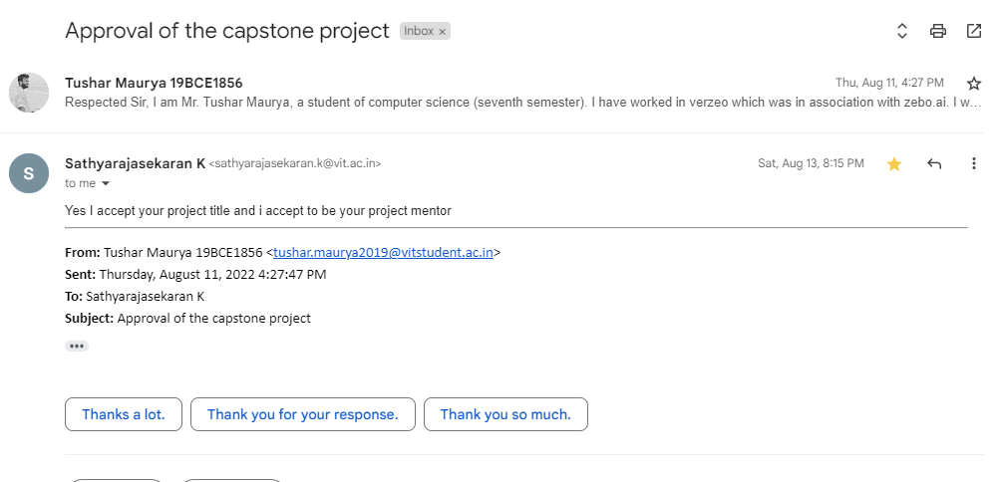
Guide Approval Snapshot

Slide 20
Any other additional information to be added by Guide
No, There is no additional information to be added by the Guide. My guide is very helpful, I already knew that as I studied TOC one of the toughest theoretical subjects under him and he helped me a lot even at that time. Even in the times of Covid-19, he delivered his best using a whiteboard at home. So, I thought to work under his supervision.
My idea was accepted after writing a mail to the guide and explaining everything on call.

Slide 21
References ( Same order as Literature Review)
The Impact of Customer Satisfaction and Relationship Quality on Customer Retention: A Critical Reassessment and Model Development [1997]
Thorsten Hennig-Thurau and Alexander Klee (University of Hanover)
Churn Prediction: Does Technology Matter? [2006]
John Hadden, Ashutosh Tiwari, Rajkumar Roy, and Dymitr Ruta
Scikit-learn: Machine Learning in Python [2012]
Fabian Pedregosa, Gaël Varoquaux, Alexandre Gramfort, Vincent Michel, Bertrand Thirion, Olivier Grisel, Mathieu Blondel, Peter Prettenhofer, Ron Weiss, Vincent Dubourg, et al

Slide 22
Customer Churn Prediction in Telecommunication A Decade Review and Classification [2013]
Nabgha Hashmi ,Naveed Anwer Butt and Dr.Muddesar Iqbal
An Integrated Framework to Recommend Personalized Retention Actions to Control B2C E-Commerce Customer Churn [2015]
Shini Renjith
Predicting Shipping Time with Machine Learning. [2015]
Antoine Jonquais, Florian Krempl Advisor, Dr. Roar Adland, Dr. Haiying Jia
LightGBM: A Highly Efficient Gradient Boosting Decision Tree [2017]
Guolin Ke , Qi Meng , Thomas Finley , Taifeng Wang , Wei Chen , Weidong Ma , Qiwei Ye , Tie-Yan Liu

Slide 23
Customer Lifetime Value Prediction Using Embeddings [2017]
Benjamin Paul Chamberlain, Angelo Cardoso, C.H. Bryan Liu, Roberto Pagliari, Marc Peter Deisenroth
Introduction to artificial neural networks [2018]
Enzo Grossi , Massimo Buscema
Online Fashion Commerce: Modelling Customer Promise Date [2021]
Preethi V, Nachiappan Sundaram, Ravindra Babu Tallamraju

Slide 24
Thank You

